Slide 1
Electricity Production, Use and Price Analysis
Factors influencing Calgary power prices, electrical grid load and production mix
Daniela Mañozca Cruz
Gautham Nagaraj
Jeremy Reid
Joao Ricardo Bertti Targino

Slide 2
Domain/Background of the data
Alberta established a deregulated electricity market in 1996 with the Electric Utilities Act (EUA), creating the possibility for private companies to compete for customers
The Alberta Electric System Operator (AESO) is an independent system operator leading the planning and operation of the Alberta electrical system
The AESO also collects and evaluates industry data with some data made available to the public and will be the primary data source for this project, for this project the agencies will include AESO and balancing pool
The Balancing Pool ensures stability in Alberta's electricity market by managing risks associated with power purchase agreements; contracts that facilitate the sale of electricity from power generators to consumers or retailers
The Balancing Pool administers the Power Pool, a wholesale electricity market or ‘spot market’. The Power Pool matches the lowest-priced supply with demand by establishing a pool price that is revised hourly

Slide 3




Who are the different providers?
The market has multiple private providers such as ENMAX, ATCO, ENCOR and Direct Energy
Companies have the option of generating their power and selling directly to consumers or buying short-term contracts on the spot market
The power supplied to the spot market is primarily generated by private entities, but includes public generation assets
For this project, we will be looking at the market demand and the respective generation price of ENMAX

Slide 4
Objective
Better understand the market dynamics of Alberta’s deregulated system
Study the relationship between demand and spot prices based on variables from available dataset including weather, population growth, and generation by different sources
Develop a time-series model that can visualize the difference in spot prices depending on the variables mentioned previously
Understand the different energy sources and the amount of electricity generated from each of these sources

Slide 5
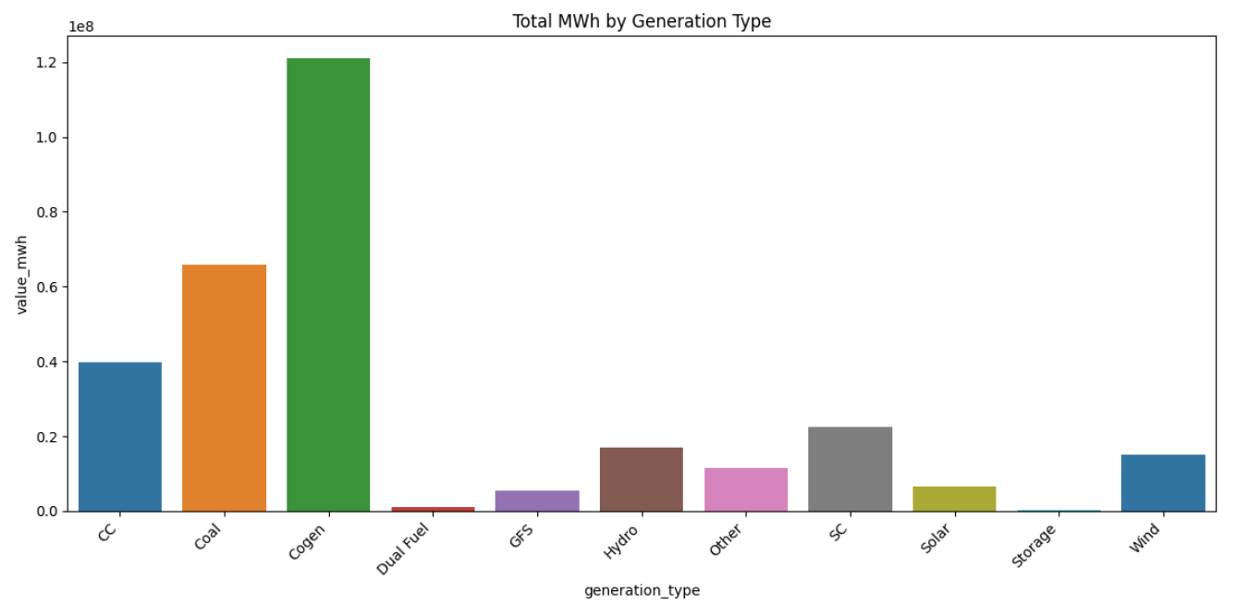
What are the different energy generation sources?
Generation sources include natural gas plants, wind farms, solar farms, hydro-electric facilities, biomass, cogeneration facilities and coal plants (which are undergoing phase out)
Although the coal plants are
being phased out, they still
lead in generation of energy

Slide 6
The Datasets
Price
Demand
Temperature
Gas Price
Generation
Population

Slide 7
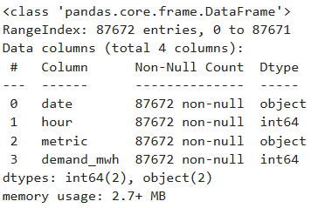

There are total of 5 datasets: Demand, temperature, gas price, generation and price.
Demand Dataset - The demand datasets consists of Alberta’s internal load/Demand consisting of the total hourly demand in MW for the entire Province combined with spot price and gas price
Visualizing the demand vs price, we can obtain an understanding of how an increase population increases the price

Slide 8
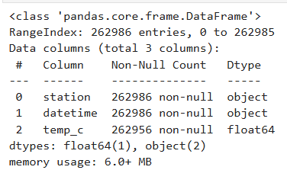

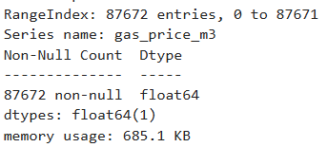

2. Temperature dataset – The temperature
dataset consists of the electricity generated vs
the temperature
We can obtain an understanding of how the
rise/fall in temperature increases the
electricity generated/demand
3. Gas Price – Cogeneration has been the source
with the highest electricity generated
Gas price will place an important role in predicting
the spot price , due to cogeneration

Slide 9
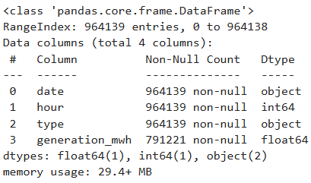

4. Generation – The generation
of electricity will play a role in
determining the spot price
There is a strong correlation
between the demand and the
generation
We can understand the impact
of the price by visualizing the
generation vs price data

Slide 10
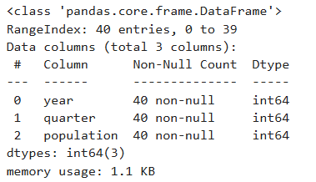

5. Population - The population will play a huge role in demand, which in turn will play a factor in determining the price
Alberta has experienced a relatively high rate of growth in recent years, due in large part to its economy
Relatively high immigration, and a high rate of interprovincial migration when compared to other provinces.
Over the past five decades, Alberta has had the highest net increase from interprovincial migration of any province.
Interprovincial migration to Alberta rises and drops dependent of the price of oil.

Slide 11
Insights gained from each dataset
Temperature data – The temperature data when joined with the generation dataset gives us some insights on what the generation value is based on the temperature
We can combine 2 datasets using an inner join based on the date column
Ordering the results by temperature, we can see which days have the highest electricity generated compared to the lowest temperatures
We are expected to see a rise in electricity generated when the temperatures drop, however a rise in temperature also increases the electricity generated

Slide 12
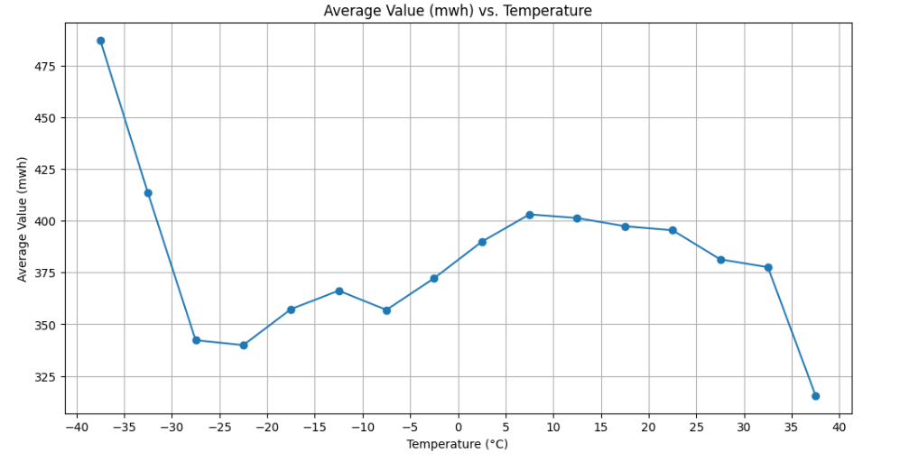
This indicates that the relationship is not linear
If we were to build a regression model, we would need to look at non-linear models or exclude the temperature variable due to non-linearity

Slide 13
Add your insights here

